Slide 1

Javascript (Enhanced Object Literals)
by
M NAVEENKUMAR
Assistant Professor
Department of Computer Science and Engineering
SRI RAMACHANDRA ENGINEERING AND TECHNOLOGY
Sri Ramachandra Institute of Higher Education and Research

Slide 2
ES6 Enhanced Object Literals

Slide 3
Enhanced Object Literals
Short hand property name
Short hand method name
Computed property name

Slide 4
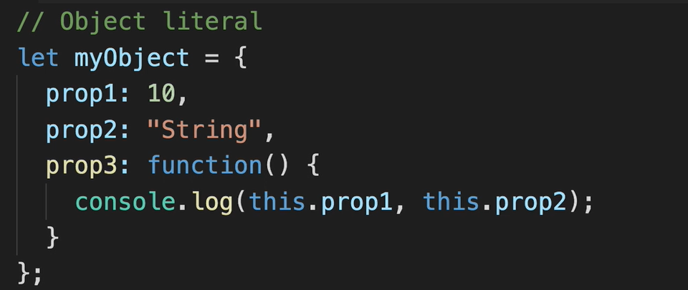
Object Literal

Slide 5
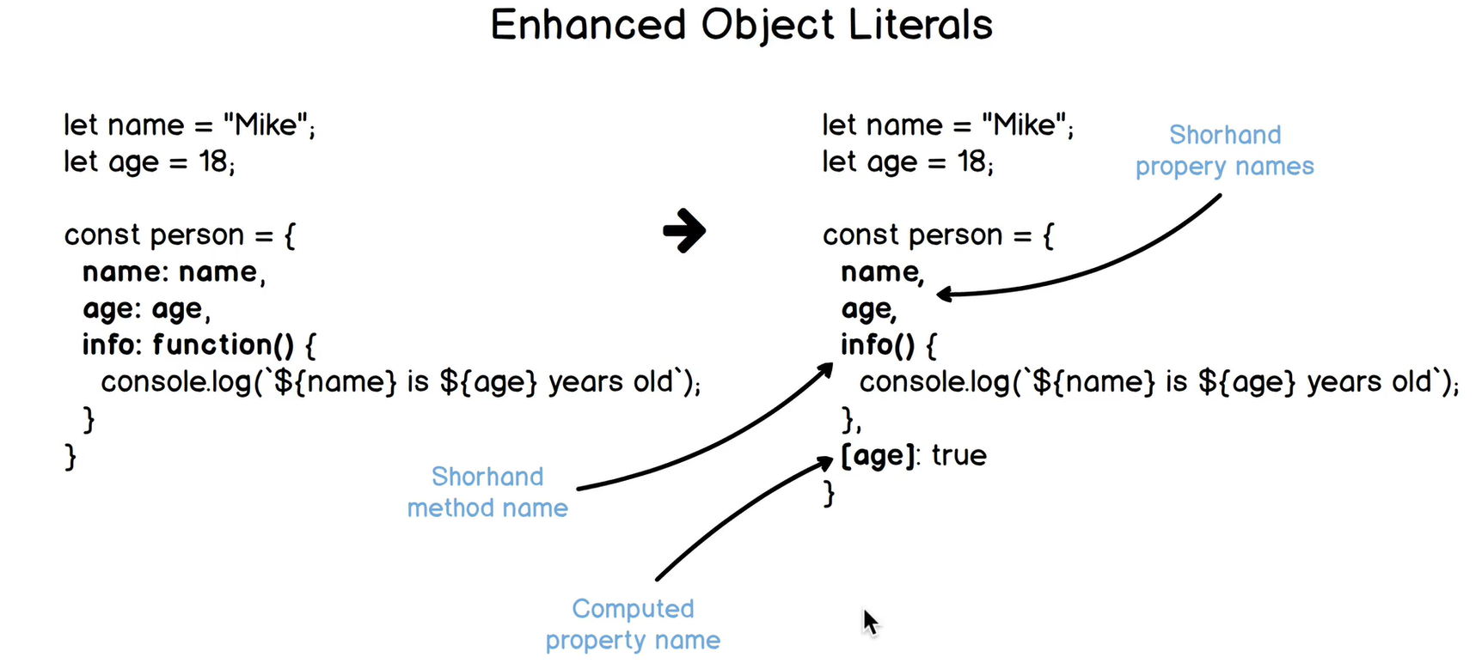

Slide 6
Short hand property name
const a = 1, b = 2, c = 3;
const obj = {
a,
b,
c
};
// obj.a = 1, obj.b = 2, obj.c = 3

Slide 7
Short hand method name
const lib = {
sum(a, b) { return a + b; },
mult(a, b) { return a * b; }
};
console.log( lib.sum(2, 3) ); // 5
console.log( lib.mult(2, 3) ); // 6

Slide 8
Computed property name
const key1 = 'one',
obj = {
[key1]: 1,
two: 2,
three: 3
};
// obj.one = 1, obj.two = 2, obj.three = 3

